Slide 1
C# Data Types- Value Type
Value type variables can be assigned a value directly. They are derived from the class System.ValueType.
The value types directly contain data. Some examples are int, char, and float, which stores numbers, alphabets, and floating point numbers, respectively. When you declare an int type, the system allocates memory to store the value.
Example:
int age=30;
char name=‘A’;
float amount=12.45;

Slide 2
C# Data Types- Value Type
The value data types are integer-based and floating-point based. C# language supports both signed and unsigned literals.
There are 2 types of value data type in C# language.
1) Predefined Data Types - such as Integer, Boolean, Float, etc.
2) User defined Data Types - such as Structure, Enumerations, etc.

Slide 3
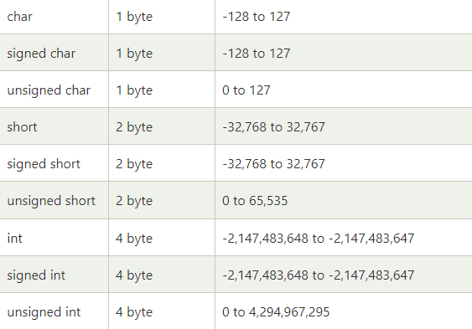
C# Data Types- Value Type
The memory size of data types may change according to 32 or 64 bit operating system. Let's see the value data types. It size is given according to 32 bit OS.

Slide 4
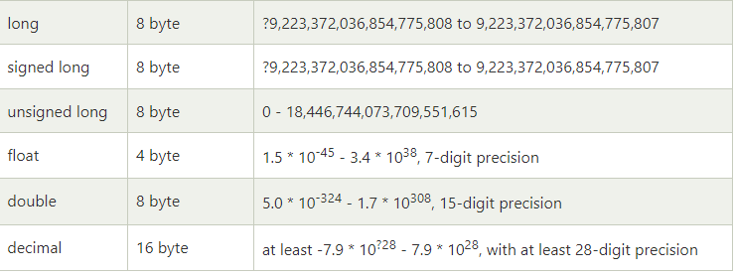
C# Data Types- Value Type

Slide 5
Next…
Data Type- Reference Type

